Slide 1
Python and OpenGL

Slide 2
What are 3D Graphics?
Traditional 2D graphics only store two-dimensional information
  x,y coordinates
  Images look like they're drawn on the screen
3D graphics hold three-dimensional information
  x,y,z coordinates
  Transform image before drawn to screen
  Graphics boards accelerate the transformations
  Lots of special features are also enabled, most of which we'll ignore.

Slide 3
What is OpenGL?
Silicon Graphics (RIP) created the Graphics Library
  Sometimes referred to as DGL
  Only ran on SGI Hardware
SGI made a open standard version of this
  http://www.opengl.org
  Licensed and ported to different machines
There is a free clone of the software available at
  http://www.mesa3d.org
  Can port anywhere

Slide 4
OpenGL Family
GL
  The basic GL library. Only primitive commands
GLU
  "GL Utilities"
  More complex commands, e.g. drawing cylinder
GLX
  "GL for X-Windows"
  Commands for drawing GL shapes in X
GLUT
  "GL Utilities Toolkit"
  More sophisticated windowing features, spheres, etc.

Slide 5
Aside: OpenGL and Games
Game manufacturers like OpenGL
  Quake, Diablo, etc.
OpenGL-compatible graphics boards are massed produced and become cheaper
No longer need $20k workstation to do molecular graphics!
Ending? Microsoft pushing people toward Direct3D...

Slide 6
Caveats before we begin
We'll only look at a small subset of OpenGL
  Balls
  Sticks
  Lighting
OpenGL is fairly difficult
  We'll begin defining libraries to make it a bit easier
  More help is welcome!

Slide 7
Hello, World
    from OpenGL.GL import *
    from OpenGL.GLU import *
    from OpenGL.GLUT import *
    glutInit("Hello, World")
    glutInitDisplayMode(GLUT_DOUBLE | GLUT_RGB |GLUT_DEPTH)
    glutInitWindowSize(400,400)
    glutCreateWindow("Hello, World")
    glClearColor(0.,0.,0.,1.)
    glutSetDisplayFuncCallback(display)
    glutDisplayFunc()
    glutMainLoop()

Slide 8
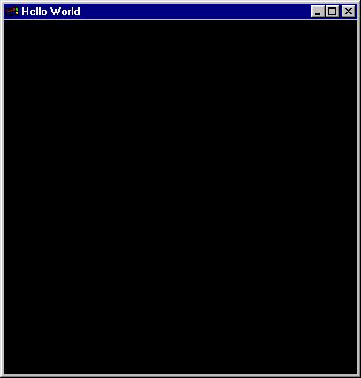
Hello, World Output
Yawn!

Slide 9
OpenGL Callbacks
The line
    glutSetDisplayFuncCallback(display)
defines a callback function.
  Just like tk used callbacks last week.
  "display" is the name of the function that draws the screen
Here's the display callback:
    def display():
    glClear(GL_COLOR_BUFFER_BIT|GL_DEPTH_BUFFER_BIT)
    glutSwapBuffers()
    return
  doesn't do anything yet
  Uses double buffering

Slide 10
Other OpenGL Callbacks
Mouse
  The mouse interaction is setup using:
    glutSetMouseFuncCallback(mouse)
    glutMouseFunc()
Motion
  The motion interaction is setup using:
    glutSetMotionFuncCallback(motion)
    glutMotionFunc()
Keyboard
  The keyboard interaction is setup using:
    glutSetKeyboardFuncCallback(keyboard)
    glutKeyboardFunc()

Slide 11
Building on Hello World
Hello, World didn't do anything other than poping up a window.
Obviously we want to do more sophisticated graphics
Display Lists are ways of holding objects to draw and redraw.
  We can have multiple display lists and flip through them
  Right now we're just going to create one
  We'll also only just put one item on the list, which is a little silly, since display lists are made to do complicated renderings.
  Display lists only have to be constructed once, which means that we can put all kinds of complex stuff on the lists and call it multiple times.
  Items put on the display lists are also executed in C, and thus render quickly.

Slide 12
Display Lists
    def init_display_list():
    glNewList(list_number,GL_COMPILE)
    glPushMatrix()
    glTranslatef(0.,1.,-1.) #move to where we want to put object
    glutSolidSphere(1.,5.,5.) # make radius 1 sphere of res 5x5
    glPopMatrix()
    glEndList()
    return
    def display():
    glClear(GL_COLOR_BUFFER_BIT|GL_DEPTH_BUFFER_BIT)
    glCallList(list_number)
    glutSwapBuffers()
    return

Slide 13
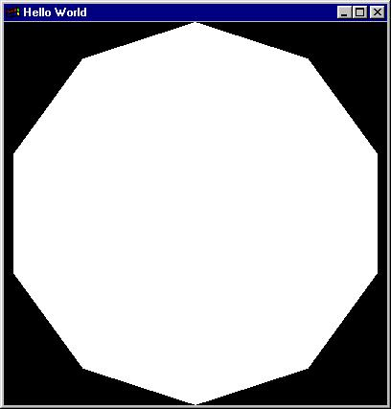
Sphere Output
Yuck!
What happened?
  Didn't add lights!

Slide 14
Lighting Models
    glEnable(GL_CULL_FACE)
    glEnable(GL_DEPTH_TEST)
    glEnable(GL_LIGHTING)
    lightZeroPosition = [10.,4.,10.,1.]
    lightZeroColor = [0.8,1.0,0.8,1.0] # greenish
    glLightfv(GL_LIGHT0, GL_POSITION, lightZeroPosition)
    glLightfv(GL_LIGHT0, GL_DIFFUSE, lightZeroColor)
    glLightf(GL_LIGHT0, GL_CONSTANT_ATTENUATION, 0.1)
    glLightf(GL_LIGHT0, GL_LINEAR_ATTENUATION, 0.05)
    glEnable(GL_LIGHT0)

Slide 15
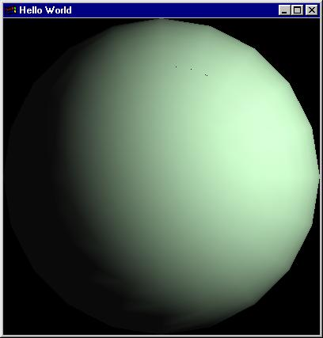
Output of Lit Sphere
A little more interesting...

Slide 16
More interesting display list
    glNewList(1,GL_COMPILE)
    glPushMatrix()
    glTranslatef(0.,1.,0.) #move to where we want to put object
    glutSolidSphere(1.,20.,20.) # make radius 1 sphere of res 10x10
    glPopMatrix()
    glPushMatrix()
    glTranslatef(0.,-1.,0.) #move to where we want to put object
    glutSolidSphere(1.,20.,20.) # make radius 1 sphere of res 10x10
    glPopMatrix()
    glEndList()

Slide 17
Define Cameras
Cameras let you define the specific viewpoint from which to look at the scene.
  Let you do things like rotate, move in/move out, pan, etc.
  Camera code:
    glMatrixMode(GL_PROJECTION)
    gluPerspective(40.,1.,1.,40.) # angle, aspect ratio, near clip, far clip
    glMatrixMode(GL_MODELVIEW)
    gluLookAt(
    0,0,10, # camera position
    0,0,0, # where camera points
    0,1,0) # which direction is up
    glPushMatrix()

Slide 18
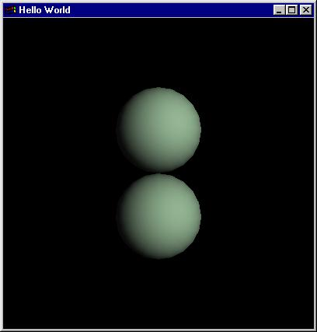
Two sphere output
Finally starting to get a bit interesting
Now we can look at interacting with the spheres.

Slide 19
Rotating the Graphics
We want to redefine our display(), mouse() and motion() functions so we can rotate the balls
Very simple code
Can also do scaling and translation the same way.

Slide 20
Updated mouse function
    def mouse(button,state,x,y):
    global beginx,beginy,rotate
    if button == GLUT_LEFT_BUTTON and state == GLUT_DOWN:
    rotate = 1
    beginx = x
    beginy = y
    if button == GLUT_LEFT_BUTTON and state == GLUT_UP:
    rotate = 0
    return

Slide 21
Updated motion function
    def motion(x,y):
    global rotx,roty,beginx,beginy,rotate
    if rotate:
    rotx = rotx + (y - beginy)
    roty = roty + (x - beginx)
    beginx = x
    beginy = y
    glutPostRedisplay()
    return

Slide 22
Updated display function
    def display():
    glClear(GL_COLOR_BUFFER_BIT|GL_DEPTH_BUFFER_BIT)
    glLoadIdentity()
    gluLookAt(0,0,10,0,0,0,0,1,0)
    glRotatef(roty,0,1,0)
    glRotatef(rotx,1,0,0)
    glCallList(1)
    glutSwapBuffers()
    return

Slide 23
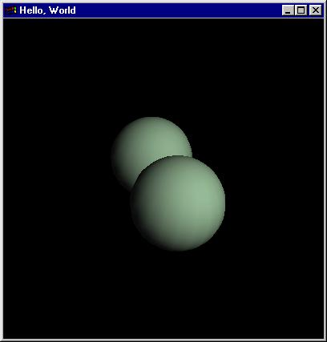
Output with Rotations

Slide 24
Render Library
A framework for molecular 3d graphics
Render module
  Inputs the files
RenderLib module
  Canvas class: top-level drawing object
  Camera class: handles camera rotations
  Lights class
  Objects class: the display list
  EventManager class: the callbacks
RenderData module
  Atom colors, radii, etc.

Slide 25
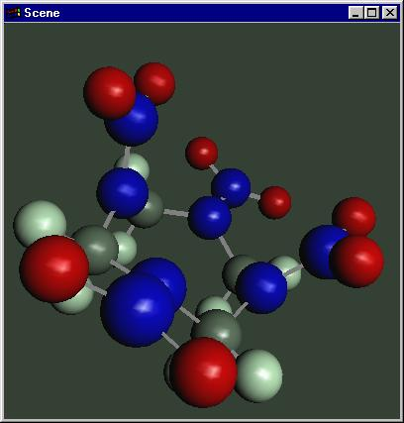

Output from the Render library

Slide 26
Final Thoughts
The commands aren't any easier in Python than in C
However, you don't have to worry about compiling or porting on different platforms
  I run the same code on Windows98 and Irix-6.4
This lets you focus on what you're doing with the rendering rather than the technology behind the rendering.

Slide 27
References
Books
  OpenGL Programming Guide, OpenGL Architecture Review Board, Addison Wesley
  OpenGL Programming for the X Window System, Mark Kilgard, Addison Wesley
Web Pages
  Python/OpenGL/Tk site: http://www.python.de

